Slide 1
Implementation of the Electronic Data Capture Tools (ePT Dashboard and HMIS) Trinidad and Tobago

Slide 2
The ePT and Rapid Test Continuous Quality Improvement (RTCQI)
1

Slide 3
The ePT and Rapid Test Continuous Quality Improvement (RTCQI)
In conjunction with the 1st and 4th pillar of the RTCQI;
The development of policies and implementation of guidelines was initiated.
A need for a standardized HTS register and Proficiency testing was identified, and implementation began.

Slide 4
The ePT and Rapid Test Continuous Quality Improvement (RTCQI)
Proficiency Testing Panels officially began in 2013 in T&T, which was manually reported.
HIV DTS Panels are produced and shipped three times yearly. Testers are required to partake in at least 2 events annually to retain their certification.

Slide 5
The ePT and Rapid Test Continuous Quality Improvement (RTCQI)
March 2022 ePT program was initiated at the National Reference Laboratory.
A training webpage was created as a learning tool for managers in April 2022.
First ePT event created and dispatched in April 2022.
Participants received instructions for login credentials as well as webpage information and instructions on how to enter reports alongside their PT panels.

Slide 6
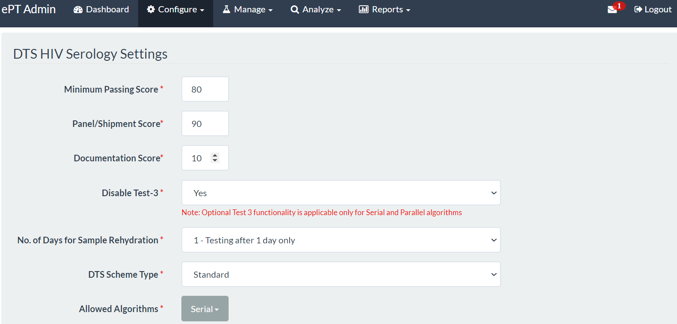
The ePT allows for the grading scheme to be aligned to the country’s algorithm, as demonstrated on this slide; Test-3 was disabled as T&T no longer utilises a third rapid kit.

Slide 7
Enrolment
Corrective Action
Panel Distribution
PT Program
Feedback
Results Submission
Data Analysis

Slide 8
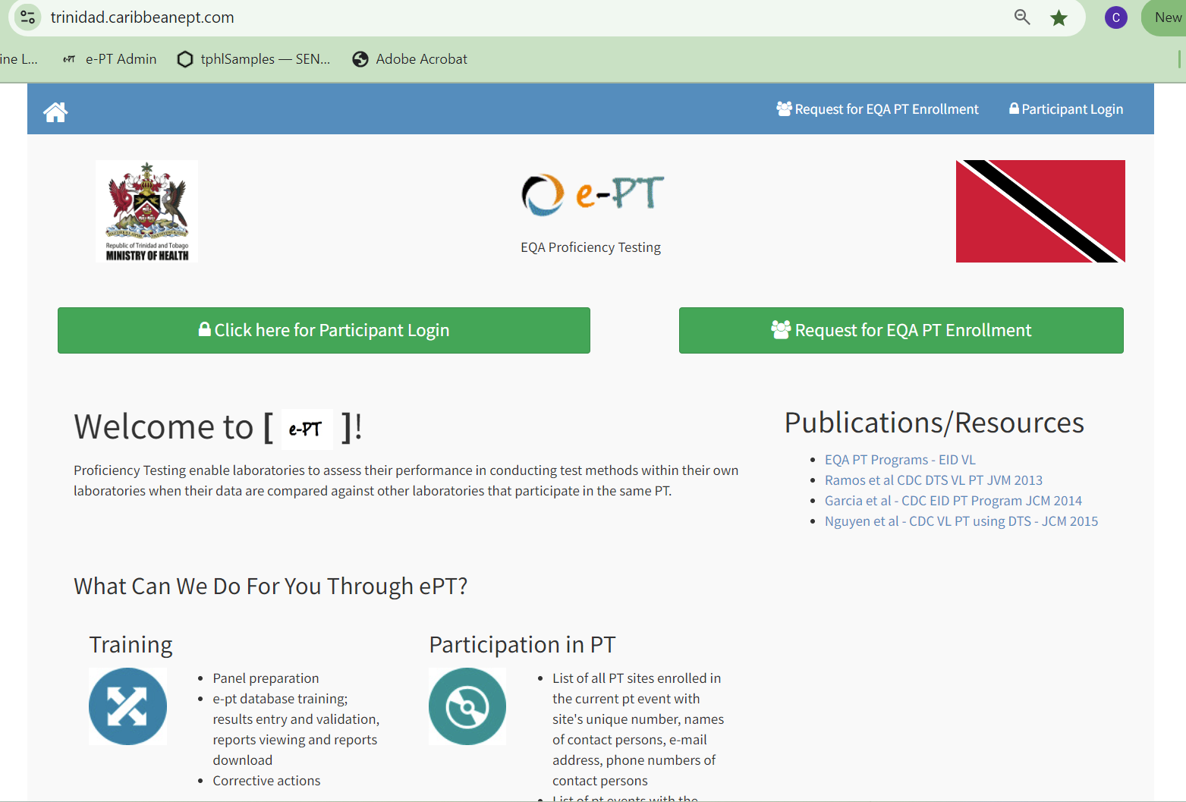

Slide 9
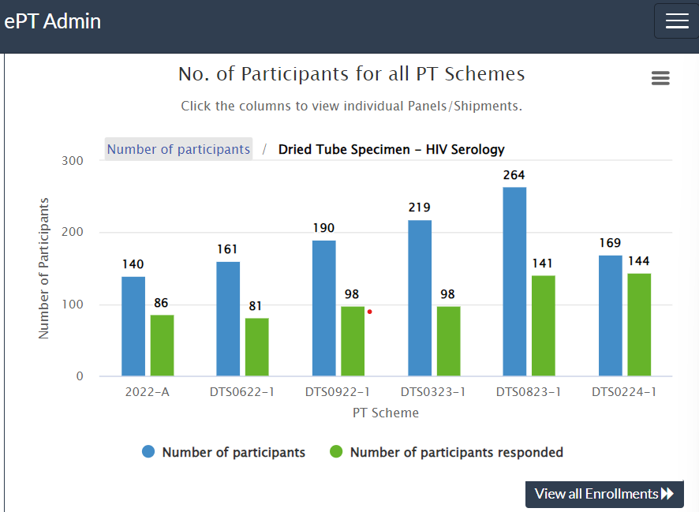
The ePT and Rapid Test Continuous Quality Improvement (RTCQI)
From 2022 to present we had 6 events, as seen on the table which shows participants enrolled/ responded in the event.
Each scheme is uniquely identified by a code generated in the system.
As training progresses, participants are enrolled into the system.
The 150 HIV DTS panels was prepared for the first four events and 200 prepared for the last two events.

Slide 10
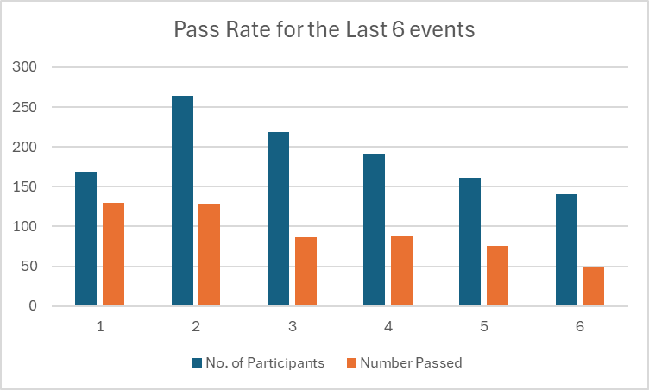
List of ePT events and status
PT Survey Code | PT Survey Date | Shipment Code | Result Due Date | Scheme | No. of Samples | No. of Participants | No. of Responses | Response % | Number Passed | Shipment Status | Download Summary Report
DTSPT2024A | 11-Mar-24 | DTS0224-1 | 19-Apr-24 | Dried Tube Specimen-HIV Serology | 6 | 169 | 144 | 85.21 | 130 | Finalised | Summary All Reports
DTSPT2023B | 04-Sep-23 | DTS0823-1 | 18-Oct-23 | Dried Tube Specimen-HIV Serology | 6 | 264 | 141 | 53.41 | 128 | Finalised | Summary All Reports
DTSPT2023A | 13-Mar-23 | DTS0323-1 | 21-Apr-23 | Dried Tube Specimen-HIV Serology | 6 | 219 | 98 | 44.75 | 86 | Finalised | Summary All Reports
DTSPT2022C | 19-Sep-22 | DTS0922-1 | 31-Oct-22 | Dried Tube Specimen-HIV Serology | 6 | 190 | 98 | 51.58 | 89 | Finalised | Summary All Reports
DTSPT2022B | 27-Jun-22 | DTS0622-1 | 03-Aug-22 | Dried Tube Specimen-HIV Serology | 6 | 161 | 83 | 51.55 | 75 | Finalised | Summary All Reports
2022-A | 01-Apr-22 | 2022-A | 31-May-22 | Dried Tube Specimen-HIV Serology | 6 | 140 | 86 | 61.43 | 50 | Finalised | Summary All Reports

Slide 11
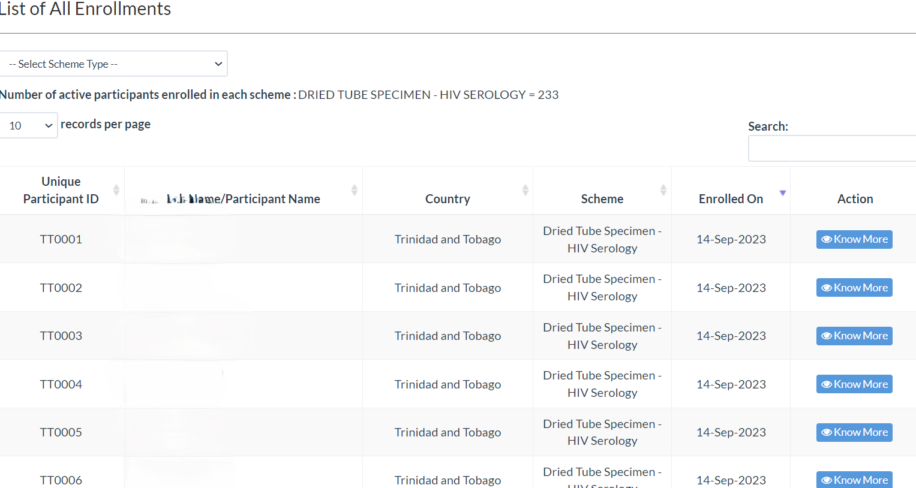
Enrolments into the ePT system
Currently there are 298 entries into the Dried Tube Specimen- HIV Serology.
With 233 Active participants.
We can keep track of the participants and see who has responded to the event throughout the timeframe in which it is opened.
This information can be downloaded and exported to stakeholders.

Slide 12
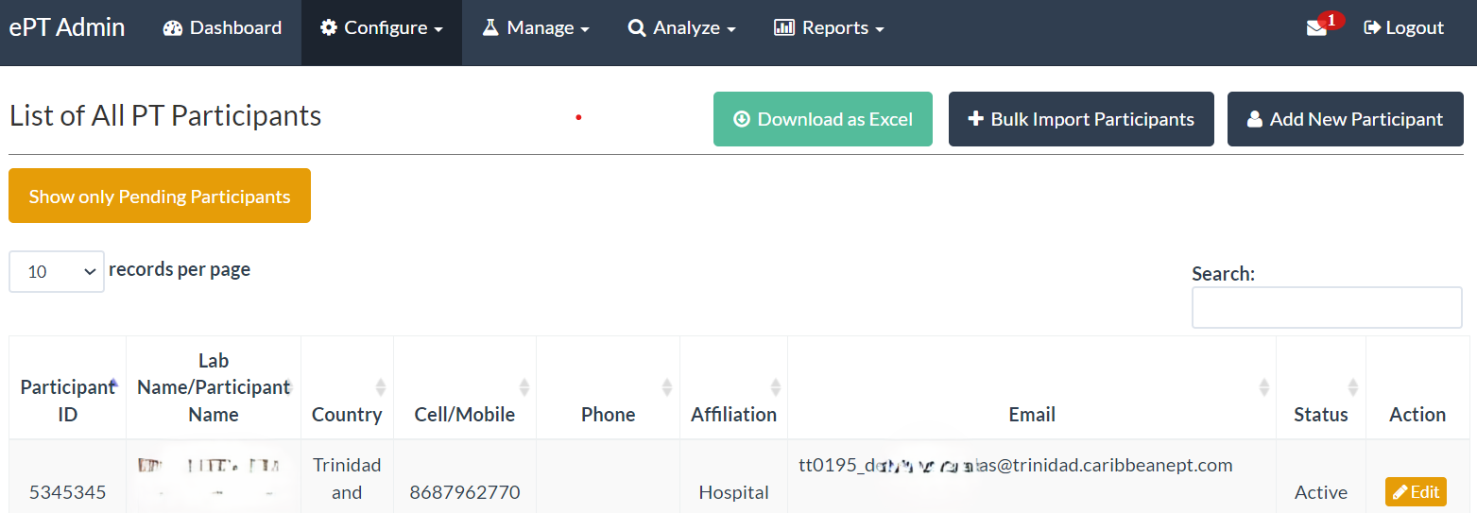
Creating new participants
Login credentials are given to participants by one of two ways; by Bulk Imports; a batch of new testers can be imputed into the system or added individually using the Add New Participants button.

Slide 13
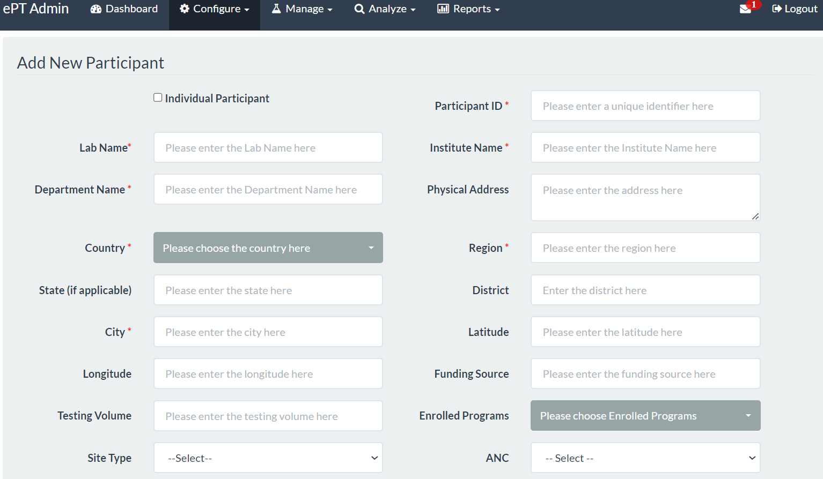
Adding new Participants
A Participant can be an individual tester or an institution.
In Trinidad and Tobago, we have opted to use individual participants, as this tool is used to assess competency for our HIV testers.

Slide 14
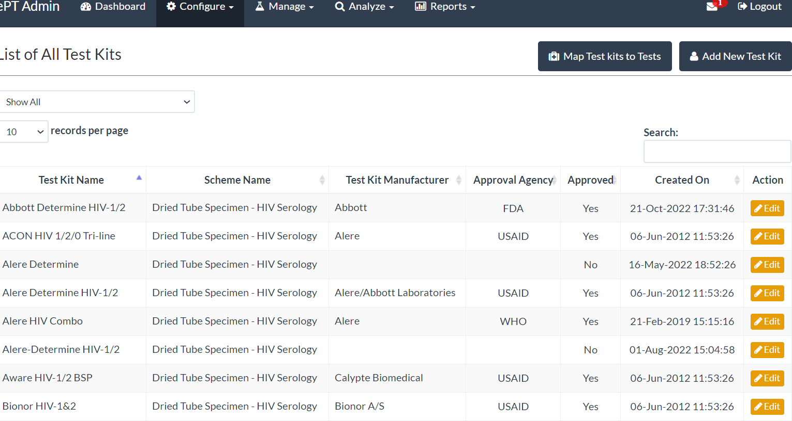
Test Kits can be added depending on the country's algorithm or de-selected as the need arises. Lists of HIV test kits used within the system and Approval Agency.

Slide 15
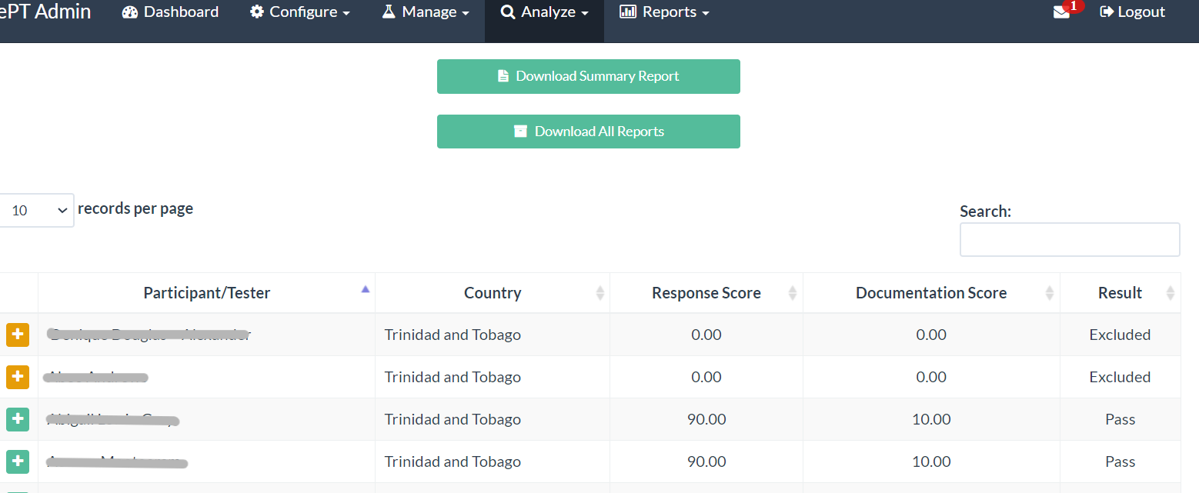
Reports can be done as a summary of the event as well as an individual tester’s reports can also be generated. We can see at a glance persons that may have failed or passed.

Slide 16
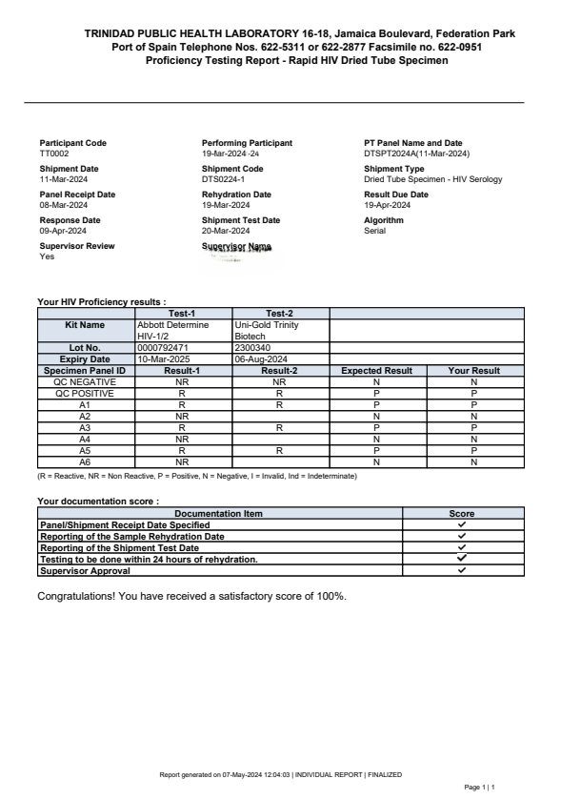
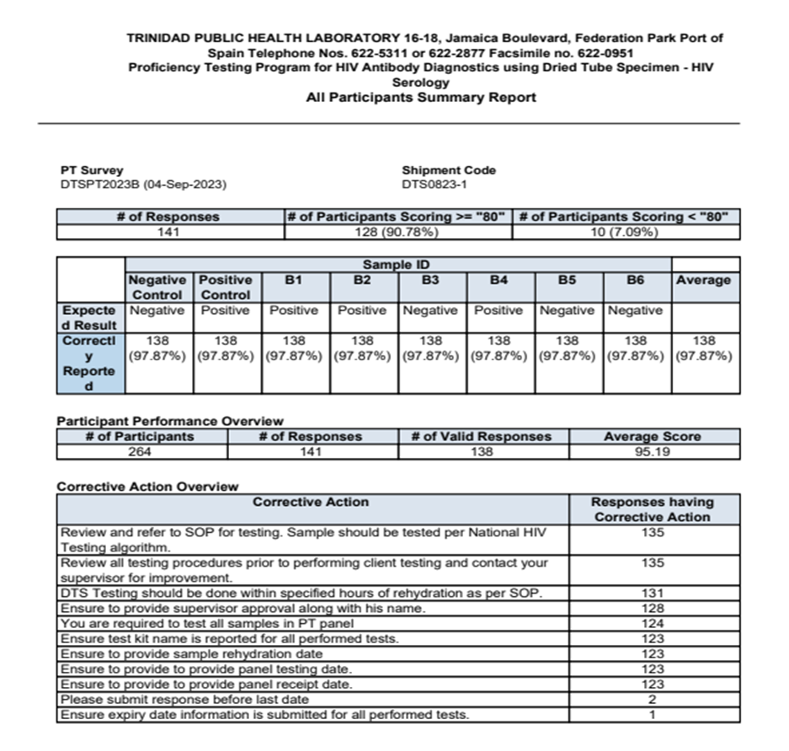

Slide 17
Some advantages of using the ePT system
Panels can be given to selected individuals.
Can be used to identify poor performance of HRT.
Creates unique identifiers for participants.
Allows for timely data analysis and corrective action.
Can be used to compare data against other testers in the program.
Can be used to evaluate competence of testers.
Monitors trends in the system.
Reduces overall turnaround time for PTs.
Provides and stores data of past PT events.

Slide 18
Data capture at HTS sites - Health Information System Assessment showed:
Facility Level
Regional
National
Manual, laborious paper-based data collection (Logbook)
Time consuming report generation
Lack of standardized process (each site has own procedures)
Incomplete logbooks
Unclear role of RHA as it relates to data flow
Unclear use of data for regional decision-making
Outdated and unstable surveillance HIS platform
Manual data entry of case reports
Manual deduplication of cases (patients retesting several places)
Manual analysis of report
Notes:
The HIV Counselling and Testing service had a manual data collection system. The HIV Counsellor/Testers at the testing site collected demographic, risk and test outcome data on the standardized HIV Case Report Form (Surveillance Form) which is paper-based. Additionally, the site-level logbook is maintained to record a minimum dataset of demographic data regarding the clients who received an HIV test during the period at the site.
To be able to report on the 1st 95, it is important, that HIV testing coverage in the population is known. The current situation only allows for reporting on the total number of HIV tests performed within a reporting period. However, data indicates that a person may have an HIV test done at multiple testing sites. The data capture system at the sites needed to be updated to correctly indicate the number of unique persons receiving an HIV test during the reporting period.

Slide 19
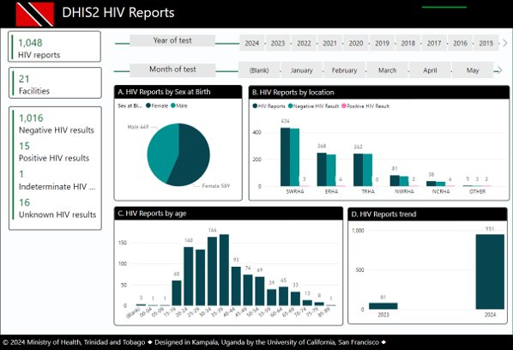
Next steps – Expansion of HMIS to collect HIV information nationally
Outdated and unstable surveillance HIS platform
Manual data entry of case reports
Manual deduplication of cases (patients retesting several places)
Manual analysis of report
Notes:
Working with CDC/PEPFAR the Ministry developed a platform on DHIS2 to capture more complete data at the HTS sites. The pilot covered 32 sites using 2 methods of information capture, a tablet and a web capture solution, done by HIV data entry personnel and/or HIV testers for each site. As shown on the slide the system captures not only demographic information but also risk behaviour, trends and location stats. The platform will act as a data warehouse, using all captured data for analysis.

Slide 20
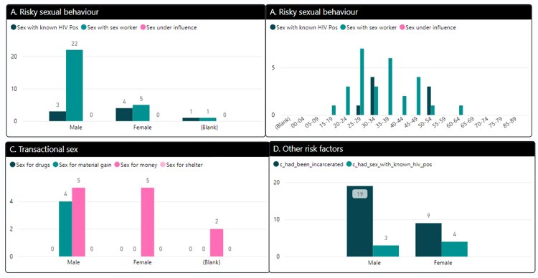
Next steps – Expansion of HMIS to collect HIV information nationally
Outdated and unstable surveillance HIS platform
Manual data entry of case reports
Manual deduplication of cases (patients retesting several places)
Manual analysis of report
Notes:
Next steps will include integration with existing systems currently in Treatment & Care facilities and laboratory systems. This would include the HIV Logbook data allowing de-duplication and cleaning of data from the HTS sites. The cleaned and merged data would provide the MOH with consolidated PLHIV data.
This will also allow monitoring of Quality Indicators which goes beyond what is currently monitored by the ePT and standard logbook.

Slide 21
Final tips and takeaways
Electronic data capture systems;
Supports the first 95% of the new UNAIDS targets.
Helps to ensure that an individual seeking HIV testing receives accurate results.
Allows for quality measures to ensure accuracy of testing.
Innovative data driven strategies and approaches can be implemented to ensure quality assurance.

Slide 22
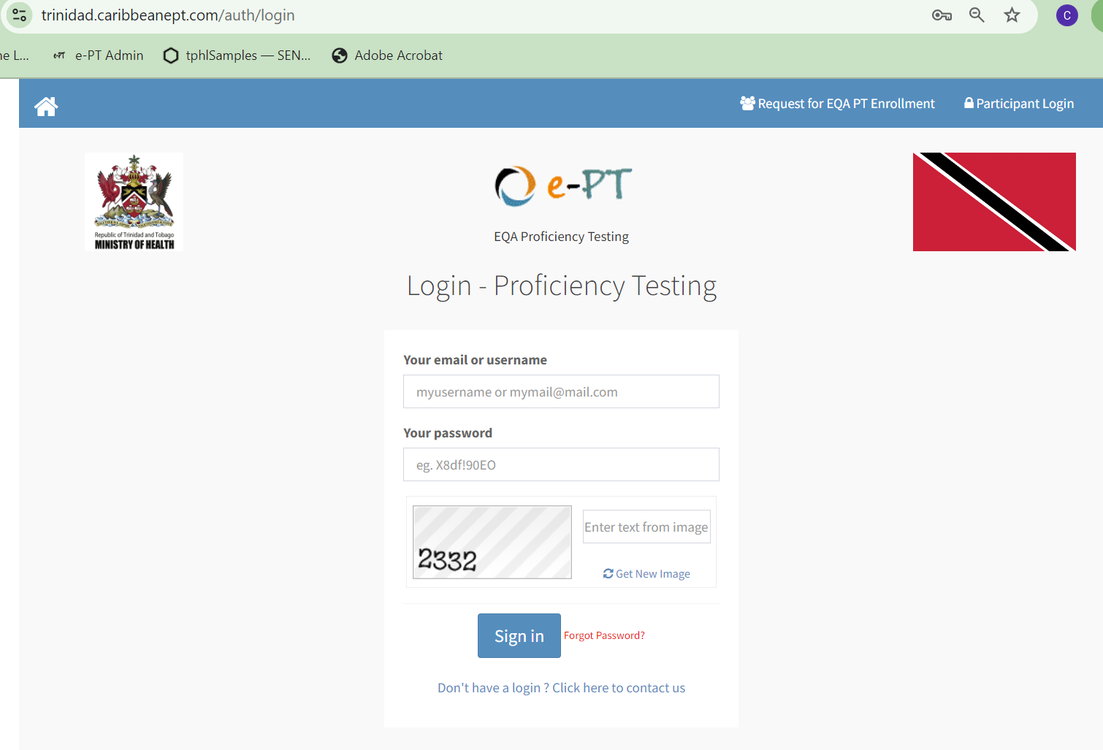
Ministry of Health
www.health.gov.tt
Trinidad Public Health Laboratory
tphl@health.gov.tt
Cindy Scott-Youk See
cindy.scott-youksee@health.gov.tt

Slide 23
Conclusion
Any questions?

Slide 24
THANK YOU !
#63 Park Street, Port-of-Spain, Trinidad and Tobago www.health.gov.tt 1-868-627-0010
Ministry of Health, Trinidad and Tobago

